Slide 1
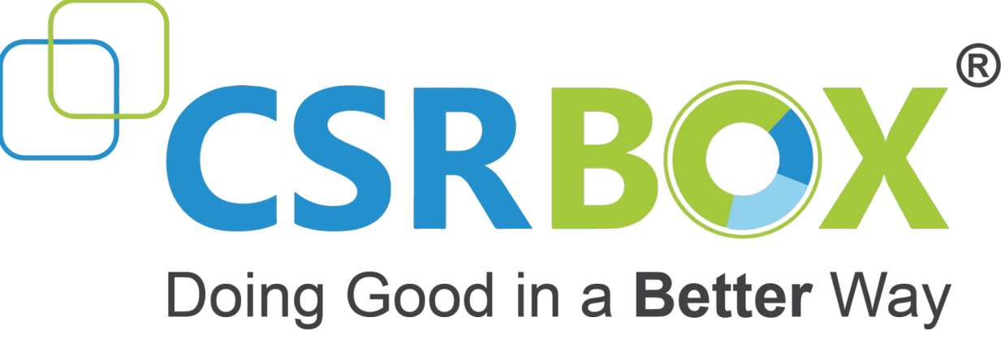
IBM SkillsBuild for Adult Learners - Data Analytics Data Analytics Internship Program 2024 Final Project Presentation
Project Name : CLEAN WATER AND SANITATION ANALYSIS
Unique ID : IBM2709
Team Name : Analytical Aces
College Name : Mangalmay Institute of Engineering and Technology

Slide 2


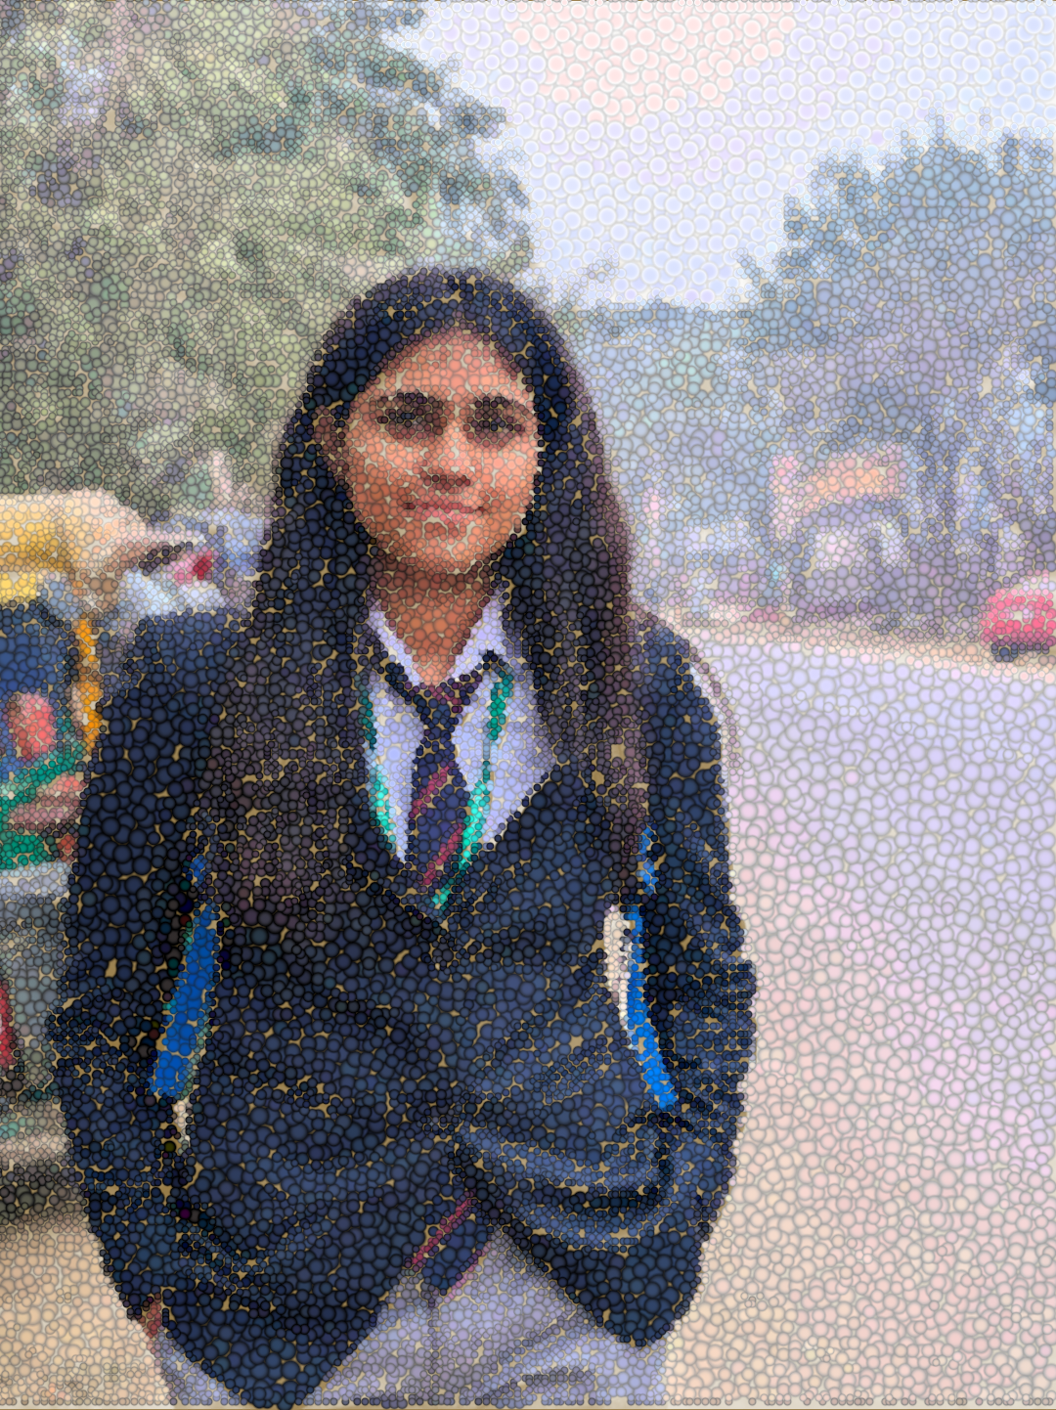

TEAM MEMBERS
David Singh
(Team leader)
Payal Tiwari
Jesica Yadav
Fahad Dilshad

Slide 3
1.1 Overview of the project
1. INTRODUCTION
Access to clean water and sanitation is a critical issue affecting billions of people globally. Despite significant efforts, many communities still lack safe drinking water and proper sanitation facilities, which are essential for health, well-being, and economic development.
This project aims to analyze data related to water and sanitation to identify key challenges and propose actionable solutions aligned with Sustainable Development Goal 6 (SDG 6): Clean Water and Sanitation.
SDG 6 seeks to ensure availability and sustainable management of water and sanitation for all.

Slide 4
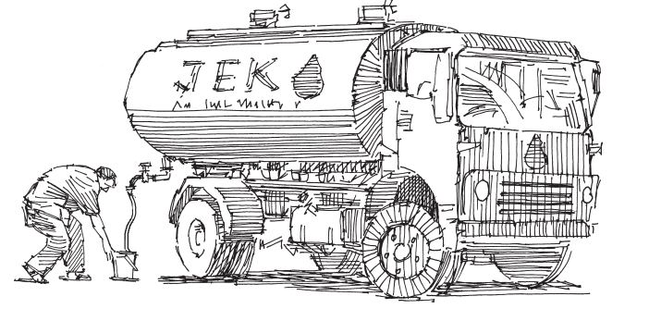
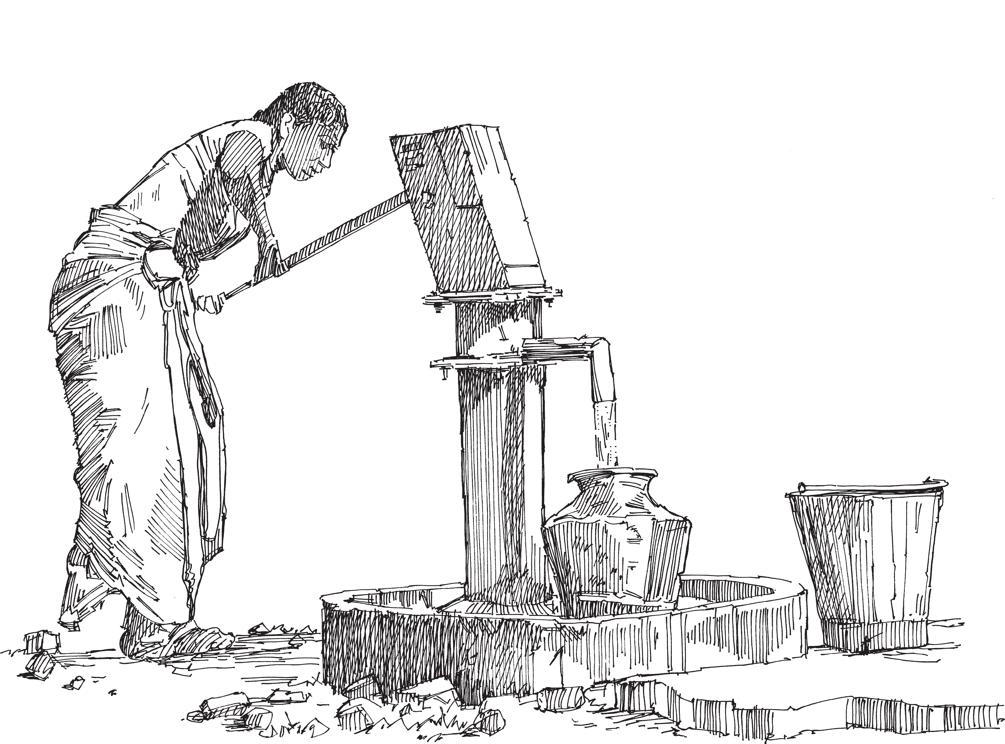
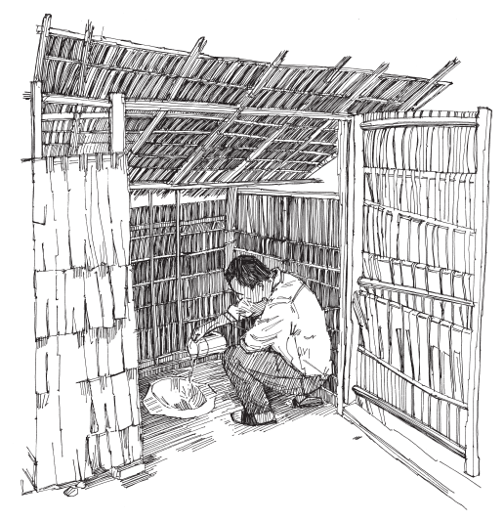
1.2 Objective
To analyse Drinking water, Sanitation and Hygiene data.
To identify the primary factors contributing to lack of access to clean water and sanitation.
To understand temporal and spatial trends in water and sanitation access.
To propose actionable solutions and policy recommendations to enhance access to clean water and sanitation.
To assess the potential impact of these solutions on achieving SDG 6.
Notes:
Names

Slide 5
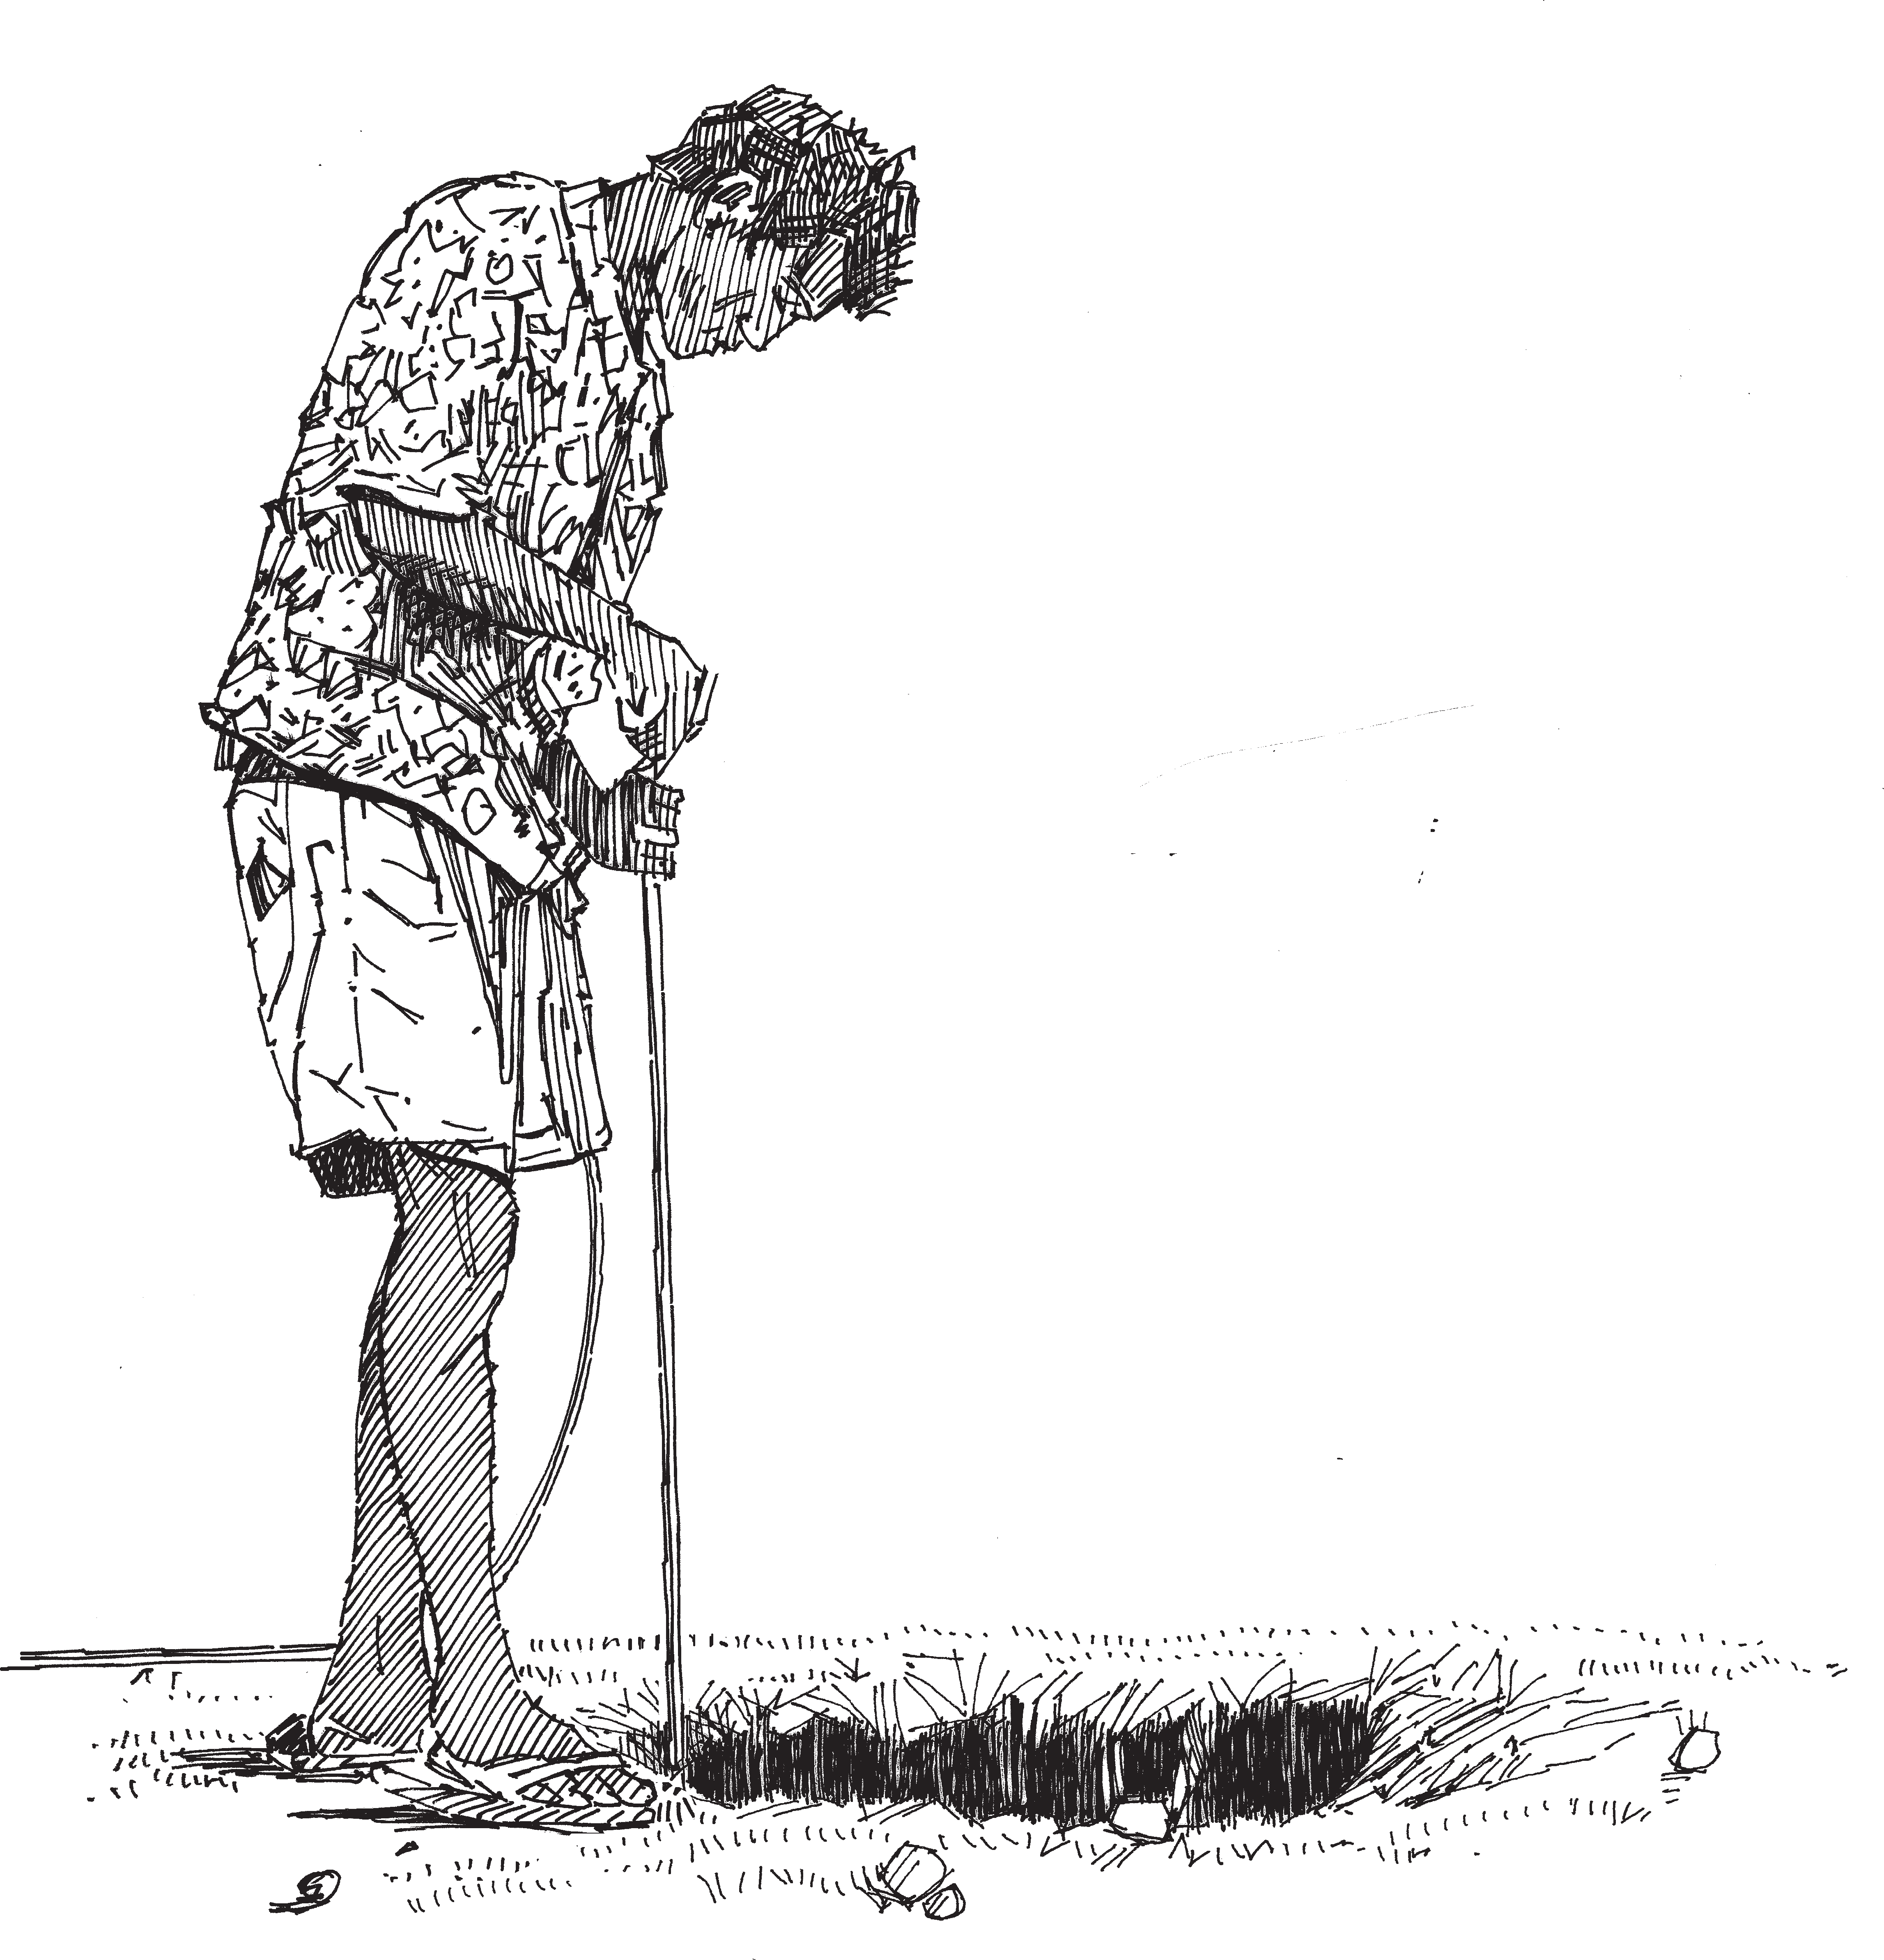
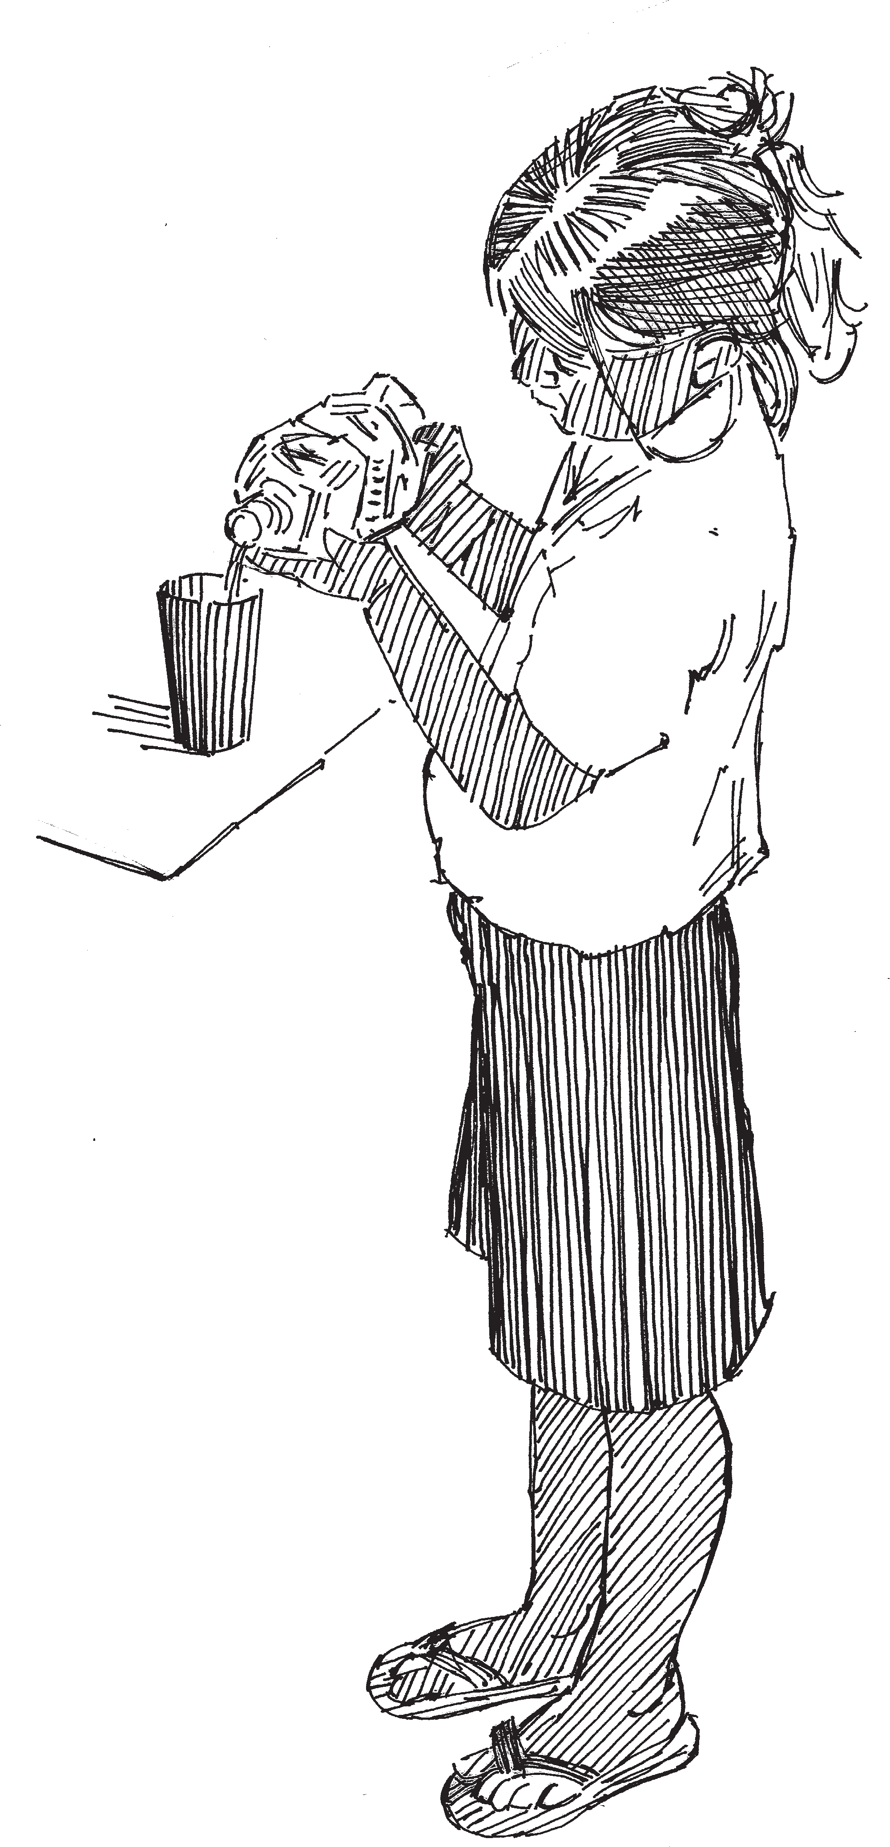
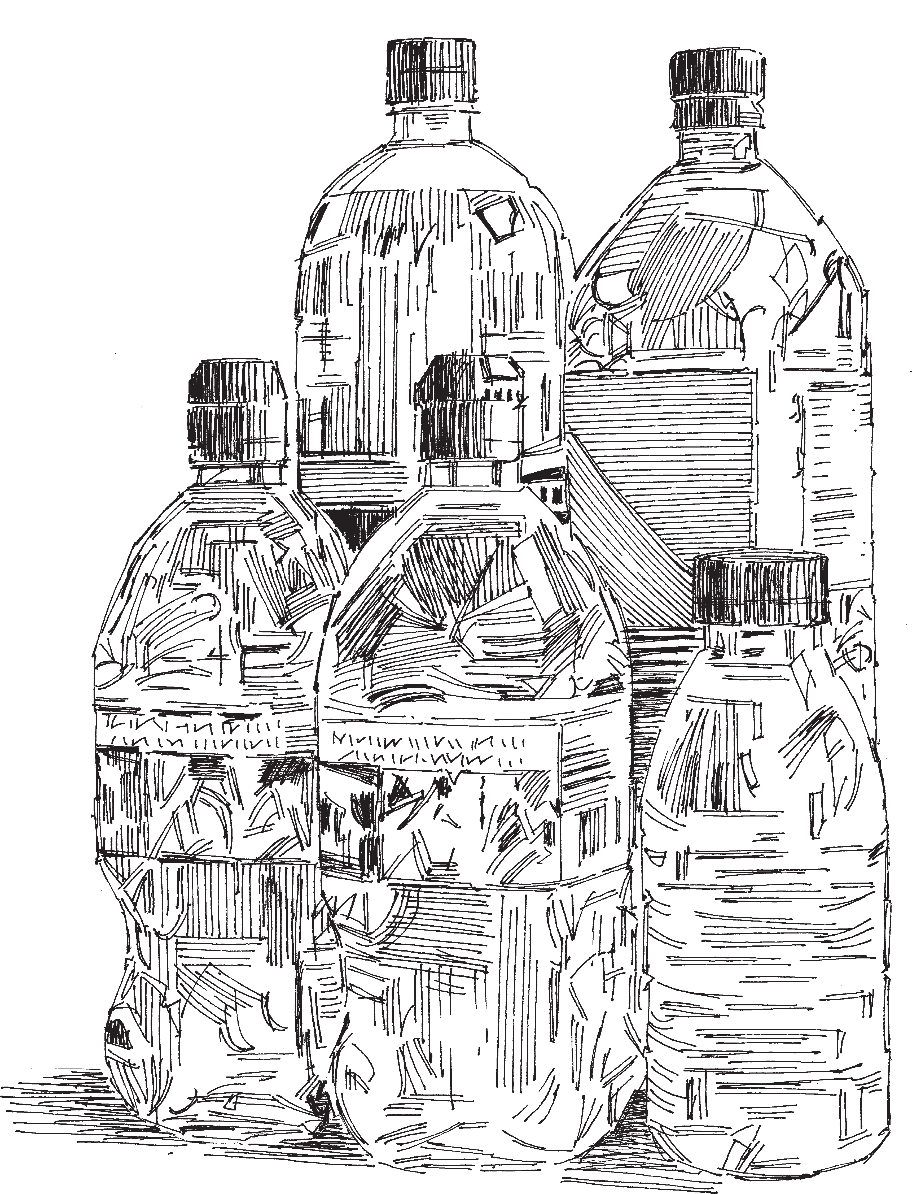
2.1 Problem Statement
2. PROBLEM IDENTIFICATION
As of 2022, 2.2 billion people still lacked access to safely managed drinking water, and 3.5 billion people did not have access to safely managed sanitation.
Droughts and severe water scarcity affect billions, posing significant risks to social stability and economic development.
Despite improvements, achieving universal access by 2030 requires accelerated efforts.
This project addresses these challenges by analyzing relevant data to identify trends, key issues, and propose data-driven solutions to improve water and sanitation access globally.

Slide 6
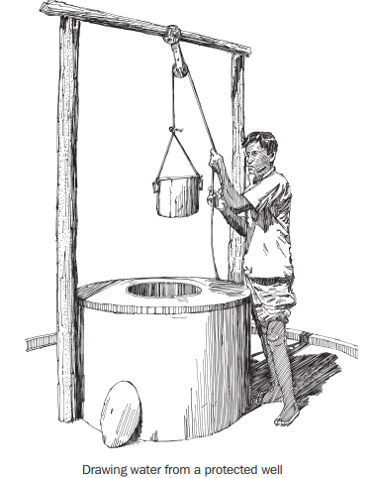
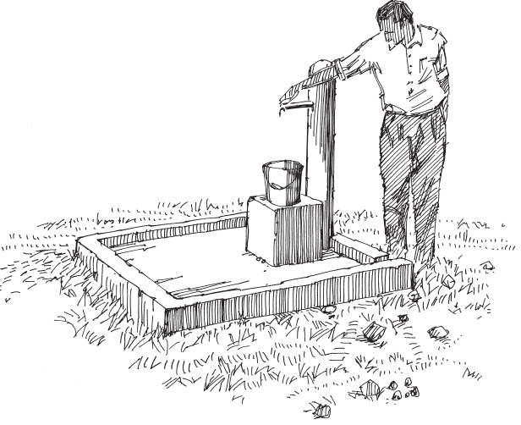
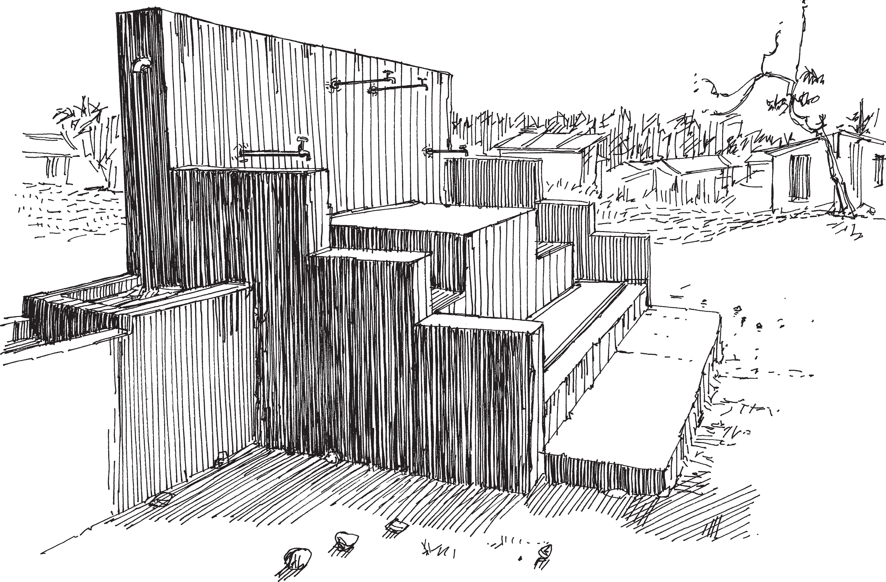
2.1 Significance Of The Problem
2. PROBLEM IDENTIFICATION
Access to clean water and sanitation is essential for health, well-being , and economic productivity.
It is a fundamental human right and a critical component of sustainable development.

Slide 7
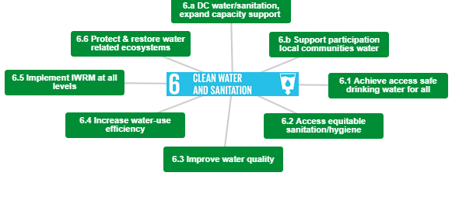
2.2 Relevant SDGs
2. PROBLEM IDENTIFICATION
SDG Goal 6: Clean Water and Sanitation
6.1 Access Safe drinking water for all
6.2 Access equitable Sanitation/Hygiene

Slide 8
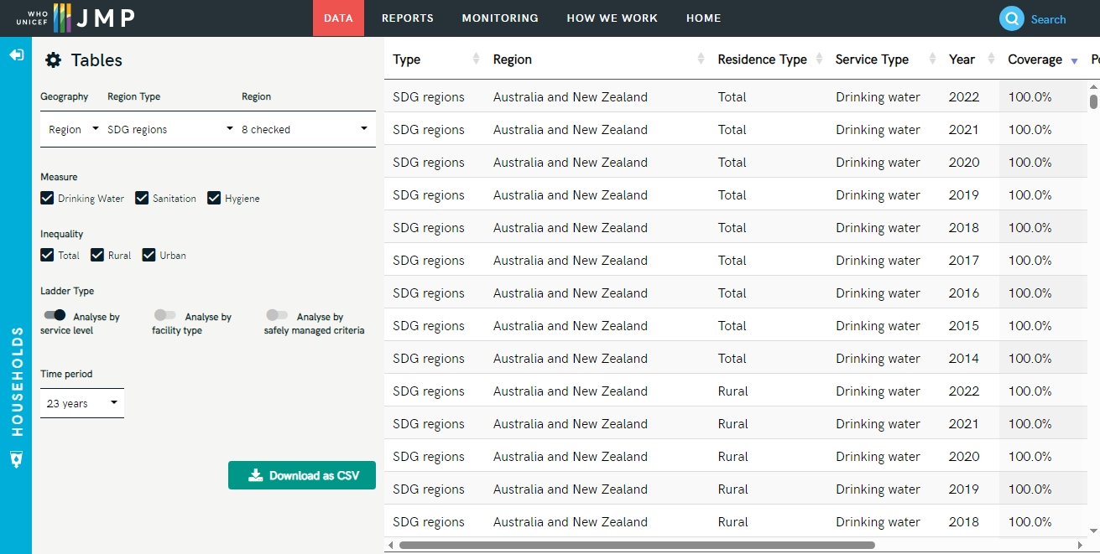
3.1 SOURCES OF DATA
3. DATA COLLECTION
Website name : JMP Data
Link : https://washdata.org/data/household#!/table?geo0=region&geo1=sdg

Slide 9
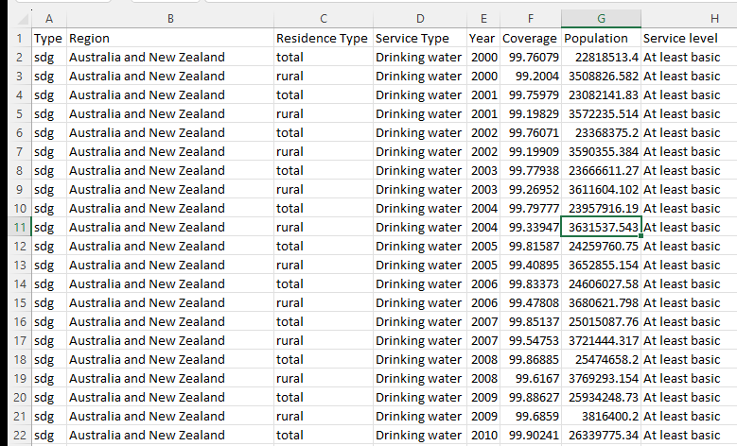
3. DATA COLLECTION
3.2 DATA DESCRIPTION
SAMPLE OF DATA
The key features of the dataset includes :
Region : SDG 8 regions
Australia and New Zealand
Northern Africa and Western Asia
Oceania
Central and Southern Asia
Eastern and South-Eastern Asia
Europe and Northern America
Latin America and the Caribbean
Sub-Saharan Africa
Service Type : Drinking water, Sanitation, Hygiene
Time: Temporal data including year of recordings.
Demographics: Population density, urban and rural population.

Slide 10



3.3 DATA COLLECTION METHODs
3. DATA COLLECTION
Data Collection methods are techniques used to gather information for research , analysis, or decision-making.
We used
Existing Data sources : means we collected “Secondary data” which involves pre-existing data from sources such as UN, WHO, UNICEF and JMP(Joint Monitoring Programme) databases, based on
Surveys and Questionnaires
Interviews
Observations and
Experiments
About Clean water and Sanitation access throughout the various regions of the world

Slide 11
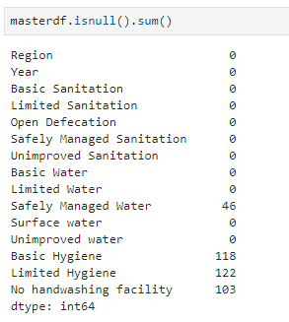
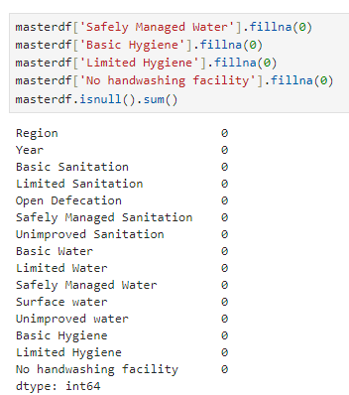
4.1 Data Cleaning Methods
4. DATA PREPROCESSING
We used following data cleaning methods :
Removing Duplicate rows
Dropping unnecessary columns (by subsetting the dataset
Replacing Zero values with central measures
Correcting errors by fixing typos or incorrect values
Standardizing data formats
4.2 Handling Missing Values
Checking Null values
Replacing Null values using Imputation, means filling with a specific value, such as 0.

Slide 12
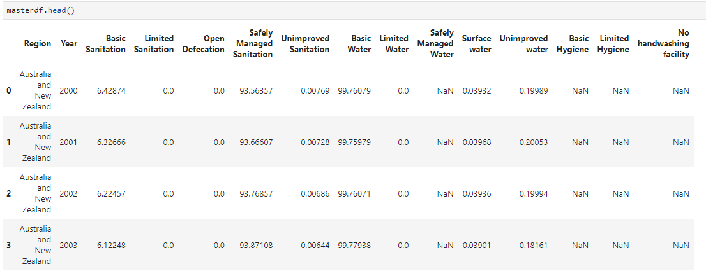
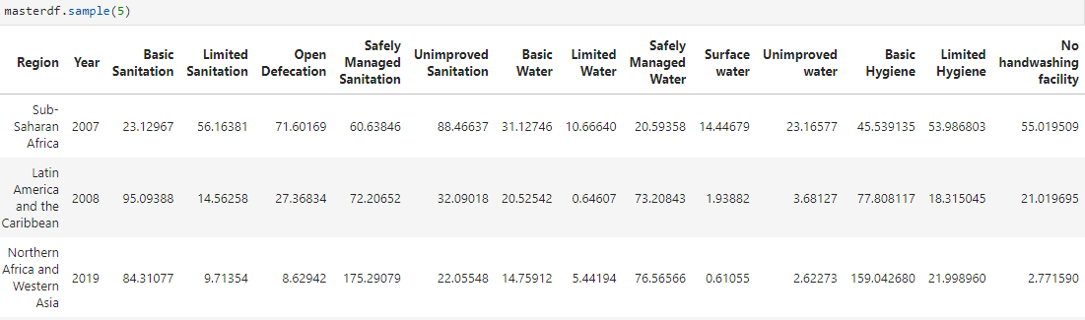
← DATA BEFORE CLEANING
DATA AFTER CLEANING →

Slide 13
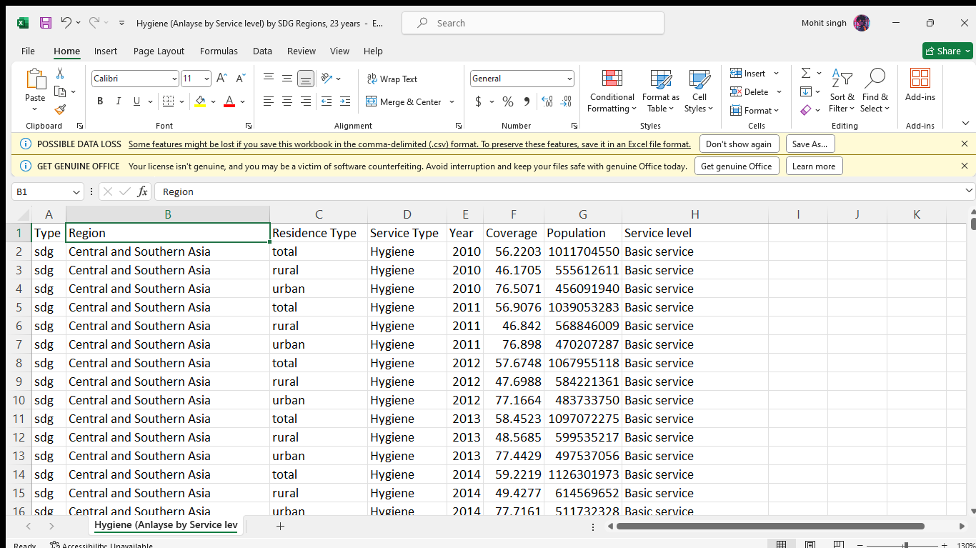
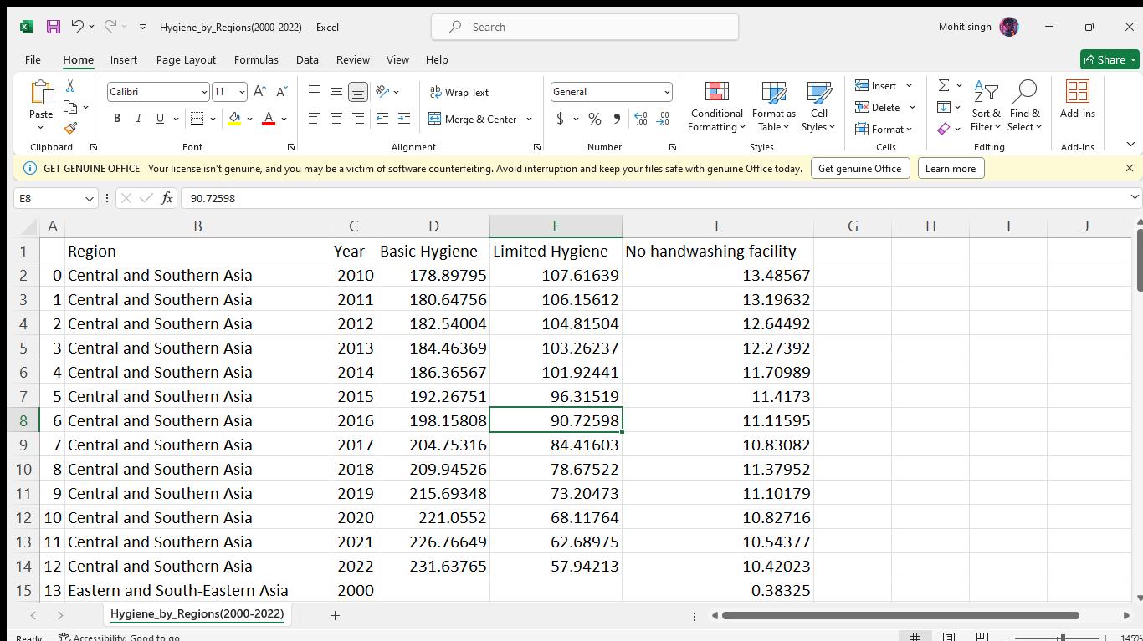
4.3 Data Transformation Techniques
4. DATA PREPROCESSING
We used following Data Transformation Techniques:
Data Aggregation : Summarizing data by combining multiple data points into a single value, such as averaging or summing.
We used 2 datasets (Hygiene_by_regions.csv) and (Sanitation_by_regions.csv), and performed above data aggregation using EXCEL
And used
Methods like “Pivoting table”

Slide 14



5.1 Analytical Tools and Methods Used
5. DATA ANALYSIS
Python libraries
Pandas
Numpy
Matplotlib
Seaborn
Sci-kit learn
Microsoft Excel
Jupyter Notebook

Slide 15
5.2 Key Findings
5. DATA ANALYSIS
Improved water source: There is a significant improvement in access to improved water sources globally.
Improved sanitation facilities: There has been a noticeable increase in the availability of improved sanitation facilities.
Urban vs. Rural disparity: A significant disparity exists between urban and rural areas in terms of access to improved water and sanitation facilities.
Geographical variations: Different regions show varying levels of access and improvement in water and sanitation services.
Policy impact: Policies and international efforts have a noticeable impact on improving water and sanitation facilities

Slide 16
5.3 Insights Derived
5. DATA ANALYSIS
Correlation between urbanization and access: Urban areas generally have better access to water and sanitation facilities compared to rural areas.
Impact of policy interventions: Countries with strong policy frameworks and international support show better improvements in water and sanitation access.
Regional challenges: Specific regions, especially in sub-Saharan Africa and South Asia, face more significant challenges in improving water and sanitation facilities.
Economic factors: Economic development is strongly correlated with better access to improved water and sanitation.

Slide 17
6.1 Formulated hypothesis
6. HYPOTHESIS DEVELOPMENT
Hypothesis 1: Urbanization positively influences access to improved water sources and sanitation facilities.
Hypothesis 2: Policy interventions and international support lead to significant improvements in water and sanitation access.
Hypothesis 3: Economic development is a primary driver for enhanced access to water and sanitation.

Slide 18
6.2 Rationale behind the hypothesis
6. HYPOTHESIS DEVELOPMENT
Urbanization hypothesis: Urban areas are typically more developed with better infrastructure, making it easier to provide improved water and sanitation services.
Policy interventions hypothesis: Countries with robust policy frameworks and international support can mobilize resources and implement programs more effectively, leading to better outcomes.
Economic development hypothesis: Higher economic development provides the necessary financial resources and infrastructure for improving water and sanitation services.

Slide 19
6.3 Method for Testing the Hypothesis
6. HYPOTHESIS DEVELOPMENT
Data collection: Gather data on urbanization rates, policy interventions, international support, and economic development indicators from various sources like World Bank, WHO, and UN reports.
Statistical analysis: Use statistical methods such as correlation and regression analysis to determine the relationships between urbanization, policy interventions, economic development, and access to water and sanitation facilities.
Case studies: Conduct case studies of countries or regions that have shown significant improvements in water and sanitation access to identify the impact of urbanization, policies, and economic factors.
Comparative analysis: Compare regions with different levels of urbanization, policy interventions, and economic development to assess their impact on water and sanitation access.

Slide 20
7.1 Proposed Solution
7. SOLUTION DESIGN
Accelerating progress through increased investment, targeted policies, and innovative solutions tailored to local contexts.
7.2 Implementation Plan
Focus on improving infrastructure, increasing funding, and enhancing community engagement.
7.3 Alignment with SDGs
Directly addresses SDG 6 targets, contributing to overall health, education, and economic outcomes.

Slide 21
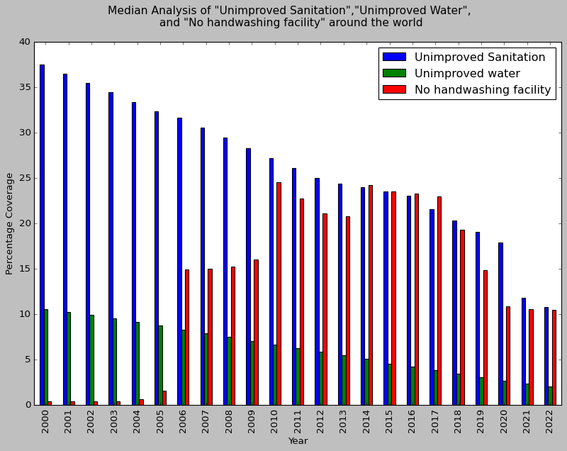
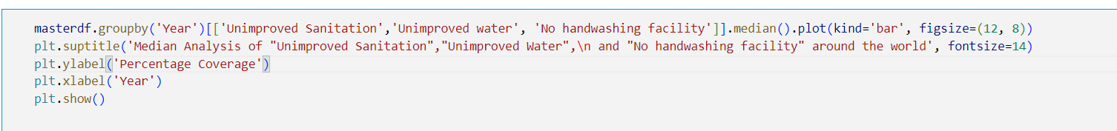
8.1 Data visualisation techniques used
8. VISUALISATION
Bar charts
Line graphs
Heat maps
8.2.1 Bar plot
Data Visualization on Unimproved
--> Following plot demonstrates the Median Percentage Coverages for
1. "Unimproved Sanitation",
2. "Unimproved Water" and
3. "No Handwashing Facility.

Slide 22
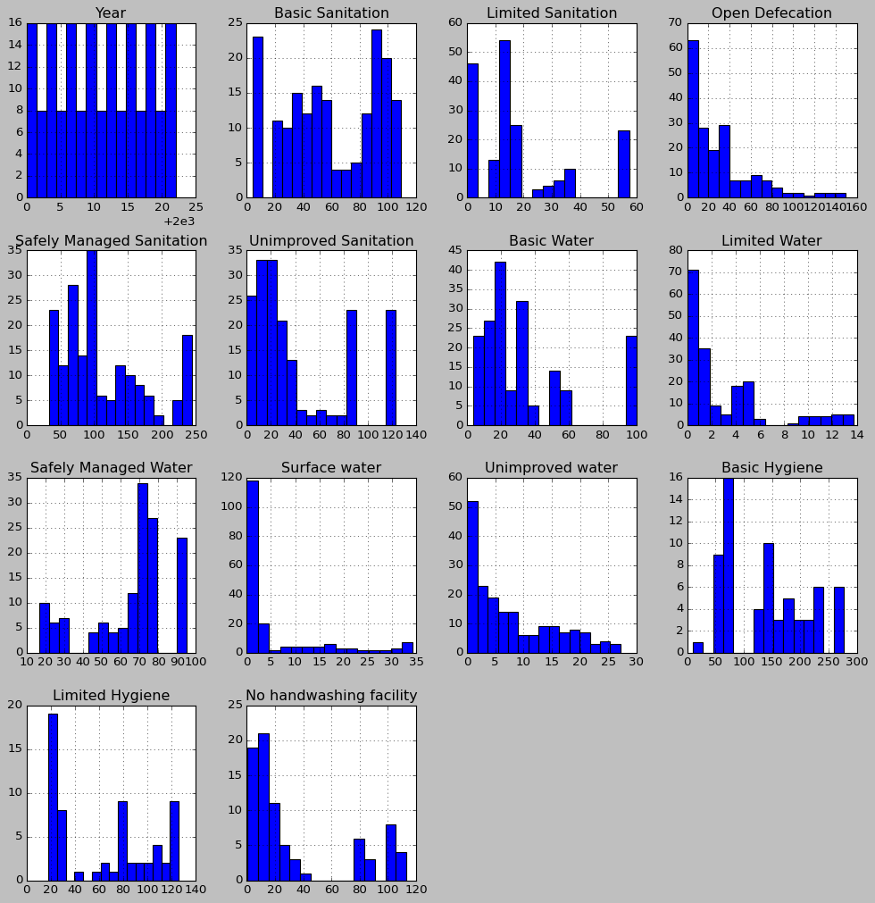
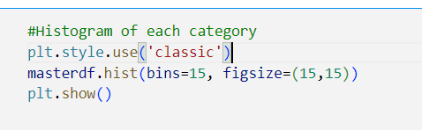
8. VISUALISATION
8.2.2 Hist plot

Slide 23
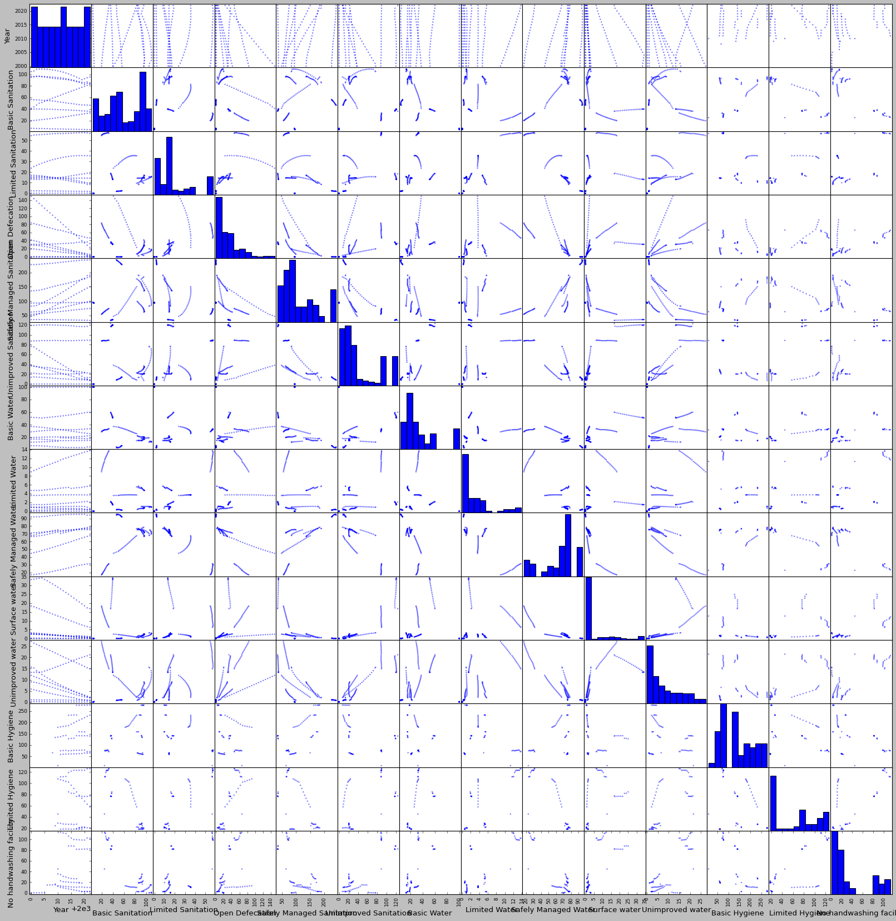
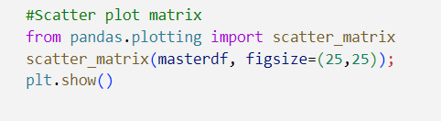
8. VISUALISATION
8.2.3 Scatter plot

Slide 24
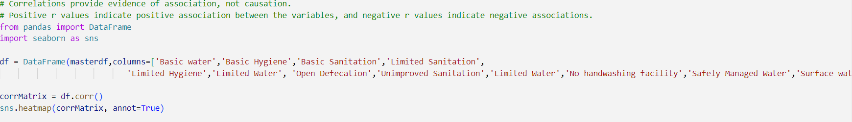
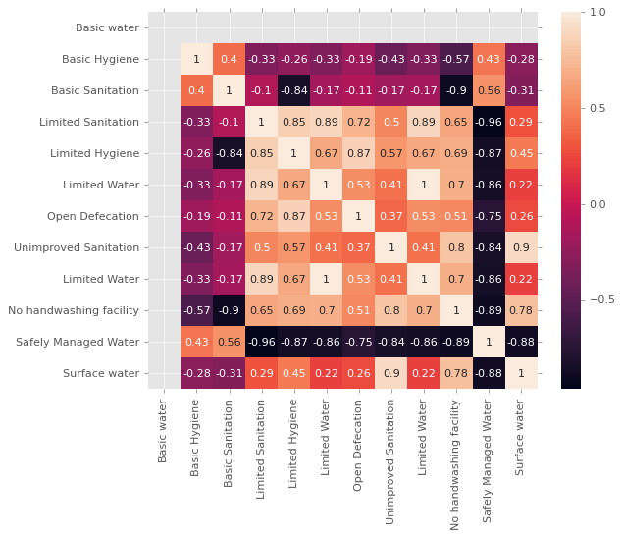
8. VISUALISATION
8.2.4 Heat Map

Slide 25
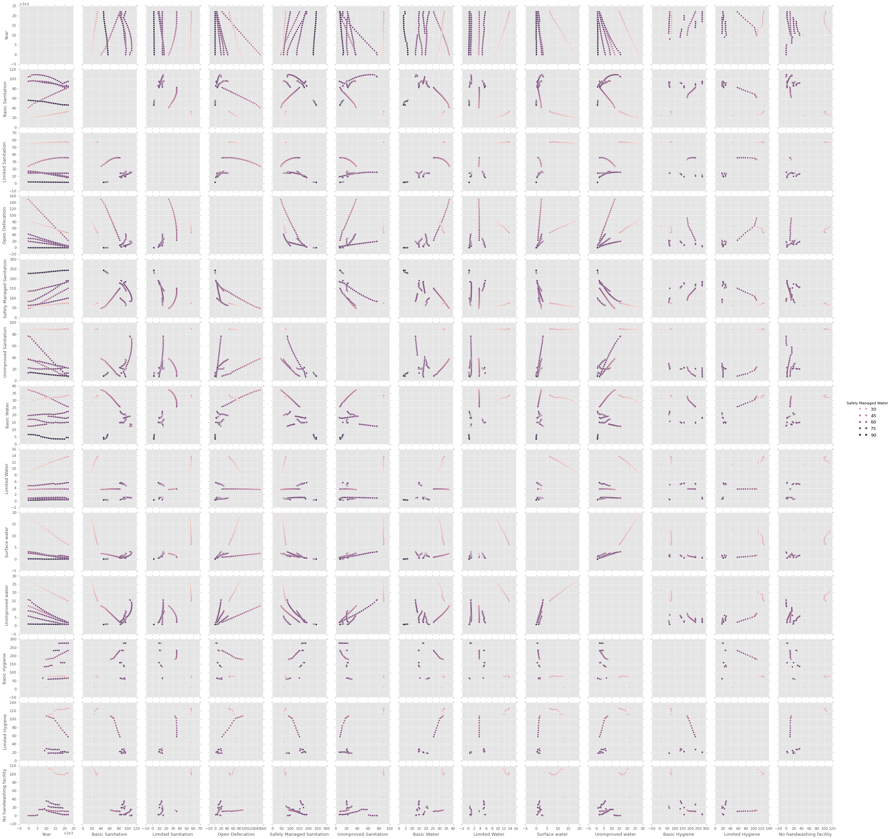
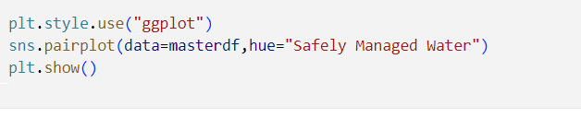
8. VISUALISATION
8.2.5 Pair plot

Slide 26
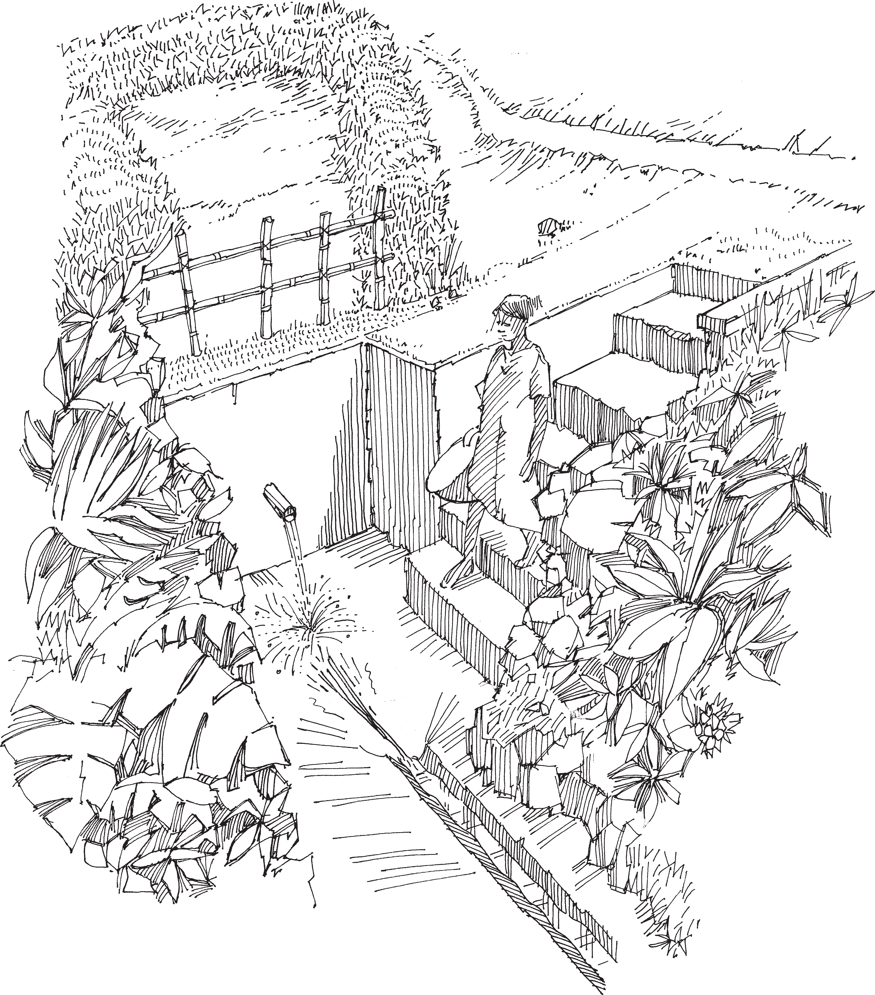
9. CONCLUSIONs
1. Limited Water & Limited Sanitation(0.89) : People with limited water access tends to practice shared sanitation facilities or use of unimproved sanitation facilities like open pits or bucket toilets.
2. Limited Sanitation & Limited Hygiene(0.85) : People with limited sanitation facilities
are likely to follow less hygienic practices like handwashing without SOAP or within a 30-min walk from home.
3. Limited Hygiene & Open defecation(0.87) : means people who are less hygienic tends to defecate on open grounds, farms, etc (especially in rural areas and less developed regions),
without using toilets for same.
4. Surface Water & Unimproved Sanitation(0.90) : People who collect unfiltered or notwell- treated water from surface sources like rivers, ponds, or lakes,etc are more tilted to practice unimproved sanitation facilities like open pits, hanging toilets,or bucket toilets on open grounds.
5. Unimproved Sanitation & No handwashing facility(0.80) : People who are not equipped with good sanitation facilities, lacks the proper handwashing facility(like with soap) or water access 30-min walk from home.

Slide 27
10. REFERENCES
Data Sources: WHO/UNICEF Joint Monitoring Programme for Water Supply, Sanitation, and Hygiene (JMP).
Tools and Software Used: Data analysis and visualization tools as used by the JMP.
Additional References: Publications and data from national surveys and international assessments.
https://washdata.org/monitoring/drinking-water
JMP (washdata.org) Interactive Charts
Number of people using safely managed drinking water sources - Our World in Data

Slide 28
Thanks!
@Analytical Aces

